Slide 1
Turn in your FLR!
Rubric
Peer edit sheet
Final Draft

Slide 2
Diseases Caused by Bacteria & Viruses

Slide 3
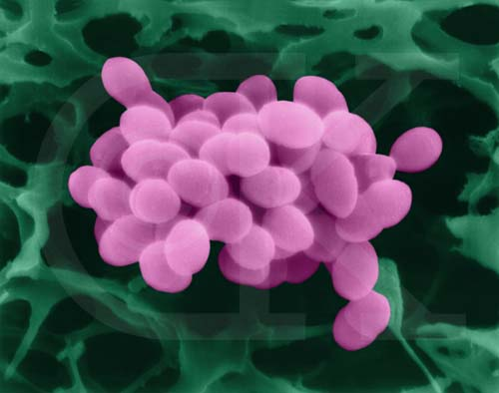
Bacteria!!!
Pathogen – disease causing agent
Interferes w/normal activities of body
Not all bacteria are pathogens
Streptococcus
causes skin & wound infections

Slide 4
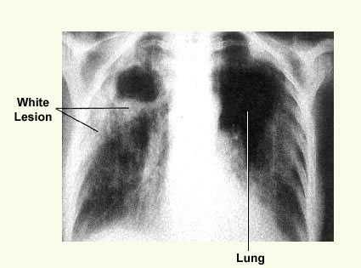
How bacteria cause disease
1. Damage cells & tissue
Break down cells for food
Ex: Tuberculosis-causing bacteria
2. Release toxins or poisons
Travel throughout body
Ex: toxic shock syndrome, food poisoning, tetanus

Slide 5
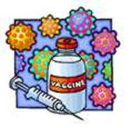
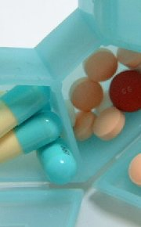
Preventing Disease
Vaccine (before infection)
Weakened or killed pathogen causes body to produce immunity to disease
Antibiotics (after infection)
Drugs stop bacteria from growing & dividing
Ex: penicillin, tetracycline
Increased human life expectancy

Slide 6
Controlling Bacterial Growth
Sterilization by heat
Most bacteria cannot survive
Disinfectants
Chemical solutions that kill bacteria
Overuse of antibacterial chemicals causing resistance
Food Storage/Processing
Cool temperatures
Steaming, frying, boiling
Chemically preserved food

Slide 7
Common Diseases Caused by Bacteria
Disease
Pathogen
Prevention
Tooth decay
Lyme disease
Tetanus
Tuberculosis
Salmonella food poisoning
Pneumonia
Cholera
Streptococcus mutans
Borrelia burgdorferi
Clostridium tetani
Mycobacterium tuberculosis
Salmonella enteritidis
Streptococcus pneumoniae
Vibrio cholerae
Regular dental hygiene
Protection from tick bites
Current tetanus vaccination
Vaccination
Proper food-handling practices
Maintaining good health
Clean water supplies

Slide 8
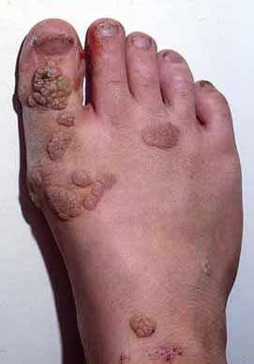
Viral Disease in Humans
Virus disrupts body’s functions
Attacks & destroys certain cells (polio)
Change cell growth pattern (papilloma virus = wart)
Antibiotics cannot kill
Vaccine best protection
Can infect animals & plants

Slide 9
Common Diseases Caused by Viruses
Type of Virus
Nucleic Acid
Disease
Oncogenic viruses
Retroviruses
Adenoviruses
Herpes viruses
Poxviruses
DNA
RNA
DNA
DNA
DNA
cancer
cancer, AIDS
respiratory infections
chickenpox
smallpox

Slide 10
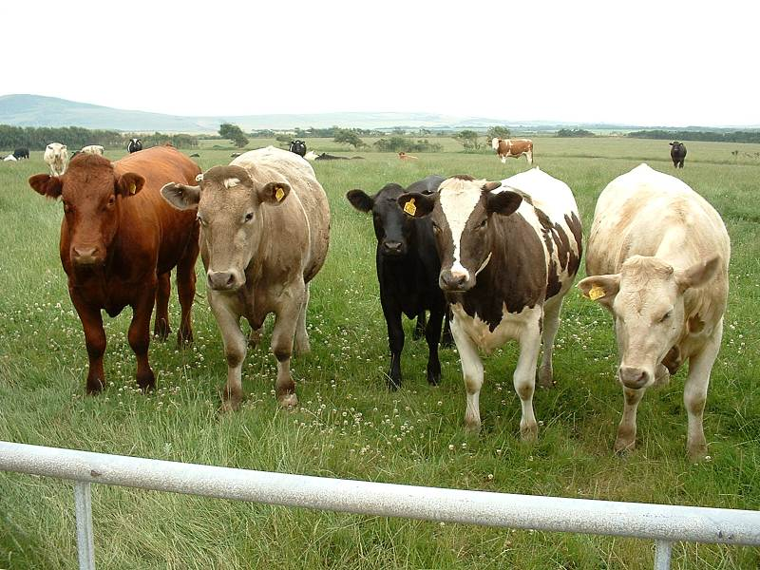
Prions
Causes disease by forming protein clumps
Contain no DNA/RNA
Protein Infectious Particles
Infects animals & humans
Ex: Mad Cow Disease & Creutzfeldt-Jakob Disease

